Slide 1
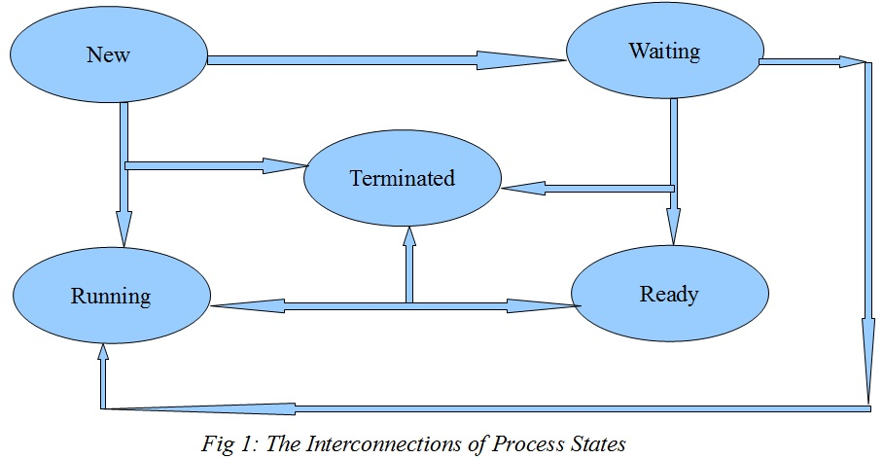
CS-3103 : Operating Systems : Sec-A (NB) : Little bit about process ➔ fork() ….
CSEN3103-BTech-SecB

Slide 2

CS3103 - Operating Systems - The Process
A process is simply an instance of a running program.
A process is said to be created (born) when the program starts execution and remains alive as long as the program is active.
After execution is complete, the process is said to terminate (die).
A process also has a name, usually the name of the program being executed.
For example, when you execute the grep command, a process named grep is created.
Process is the name given to a file when it is executed as a program.
CSEN3103-BTech-SecB

Slide 3
Mechanism of a Process Creation
Fork: A process in UNIX is created with the fork system call, which creates a copy of the process that invokes it. The process image is identical to that of the calling process, except for a few parameters like the PID. When a process is forked in this way, the child gets a new PID.
Exec: Forking creates a process but not enough to run a new program. Through exec, the child process is said to exec a new program. No new process is created here, the PID and PPID of the exec’d process remain unchanged.
Wait: The parent executes the wait system call to wait for the child process to complete.
CSEN3103-BTech-SecB

Slide 4
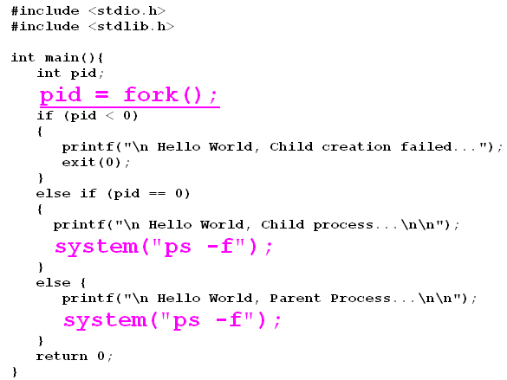
OS – Process Creation
CSEN3103-BTech-SecB

Slide 5
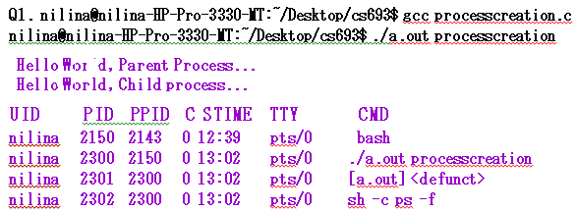
OS – Process Creation
CSEN3103-BTech-SecB

Slide 6
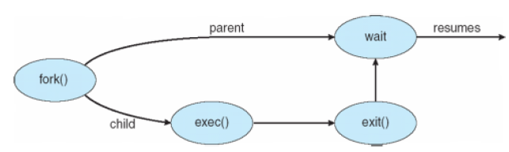
Process Creation (Cont.)
CSEN3103-BTech-SecB

Slide 7
The fork() System Call
System call fork() directs Unix to spawn a sub-task to service the request.
The purpose of fork() is to create a new process, which becomes the child process of the caller.
After a new child process is created, both processes will execute the next instruction following the fork() system call.
Therefore, we have to distinguish the parent from the child.
CSEN3103-BTech-SecB

Slide 8
The fork() System Call
If fork() returns a negative value, the creation of a child process was unsuccessful.
fork() returns a zero to the newly created child process.
fork() returns a positive value, the process ID of the child process, to the parent. The returned process ID is of type pid_t defined in sys/types.h.
Normally, the process ID is an integer. Moreover, a process can use function getpid() to retrieve the process ID assigned to this process.
CSEN3103-BTech-SecB

Slide 9
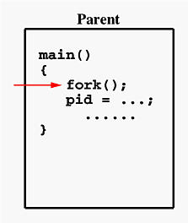
fork – create Parent and Child processes
If the call to fork() is executed successfully, Unix will make two identical copies of address spaces, one for the parent and the other for the child.
CSEN3103-BTech-SecB

Slide 10
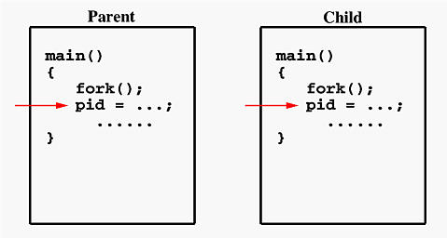
fork – create Parent and Child processes
Since every process has its own address space, any modifications will be independent of the others. In other words, if the parent changes the value of its variable, the modification will only affect the variable in the parent process's address space.
Other address spaces created by fork() calls will not be affected even though they have identical variable names.
CSEN3103-BTech-SecB

